Slide 1
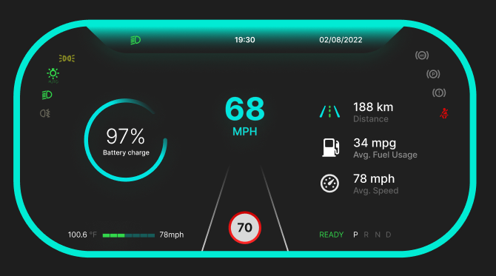
Dashboard Sytem Design
A Speed, Level, and Temperature Sensor Dashboard
Presenters: Jayesh Nikam & Team
Date:

Slide 2
Introduction & Problem Statement
Briefly introduce the concept of real-time monitoring in industrial and automotive applications.
Highlight the importance of collecting and visualizing key parameters like speed, fluid levels, and temperature.
Introduce the key components of the system:
STM32: A powerful and versatile microcontroller.
CAN Protocol: A robust communication protocol for distributed systems.
IoT NodeMCU: A Wi-Fi-enabled microcontroller for cloud connectivity.
Problem Statement:
How to design a reliable, scalable, and cost-effective system for real-time data acquisition and monitoring?
How to integrate multiple sensors and communication protocols effectively?
How to create a user-friendly dashboard for remote monitoring and analysis?

Slide 3
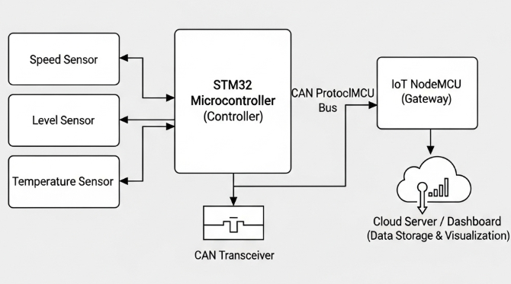
System Architecture Overview
Sensors: (Speed, Level, Temperature)
STM32 Controller: The central processing unit.
CAN Bus: The communication line connecting different nodes.
CAN Transceiver: Interface between the STM32 and the CAN bus.
IoT NodeMCU: The gateway for cloud communication.
Cloud Server/IoT Platform: (e.g., AWS IoT, ThingsBoard, Blynk)
User Dashboard: Accessible via web or mobile.

Slide 4
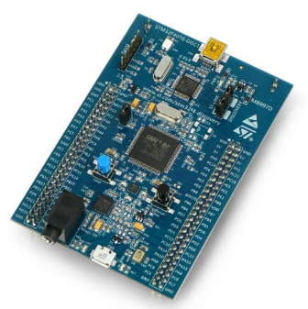
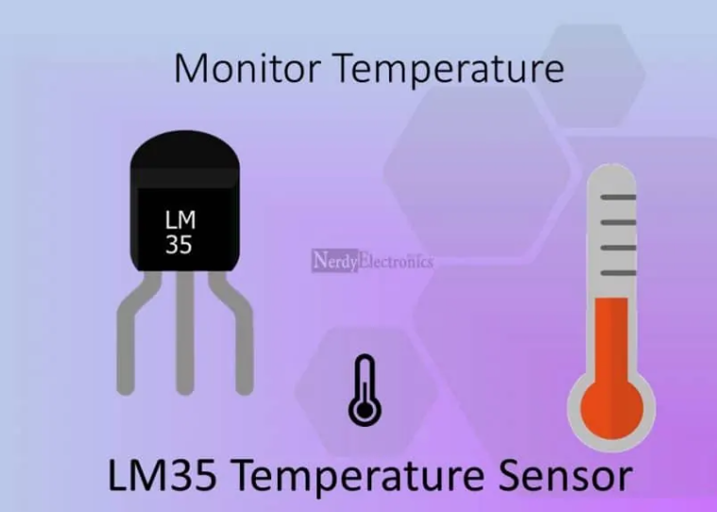
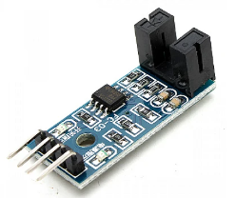
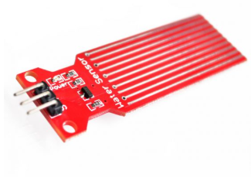
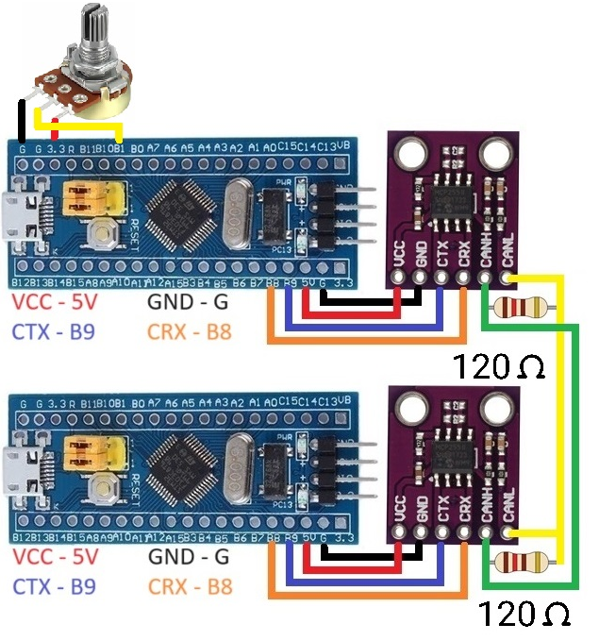
System Architecture Overview
1. STM32 Microcontroller:
Role: The brain of the system. Reads sensor data and packages it for transmission.
Key Features: High processing power, rich peripherals (including a built-in CAN controller), low power consumption.
2. Sensors:
Speed Sensor: (e.g., IR base sensor)
Level Sensor: (e.g., robado level sensor)
Temperature Sensor: (e.g., LM35)
Temperature sensor speed sensor level sensor
3. CAN Transceiver:
Role: A physical layer device that translates the TTL logic of the STM32 to the differential signal required by the CAN bus.
Example: MCP2551.

Slide 5
Communication Protocols
CAN (Controller Area Network) Protocol:
Why use it? Robust, multi-master communication protocol ideal for real-time applications in noisy environments (like vehicles or factories).
Key Features: Message-based, high-speed, reliable error detection, priority-based arbitration.
UART/Serial Communication:
Role: The primary link between the STM32 and the NodeMCU. Simple and effective for transferring the packaged sensor data.
Wi-Fi & MQTT Protocol:
Role: Used by the NodeMCU to send data to the cloud. MQTT is a lightweight, publish-subscribe protocol perfect for IoT applications.

Slide 6


Software & Programming
STM32 Programming:
IDE: STM32CubeIDE or Keil uVision.
Libraries: HAL/LL libraries for STM32 peripheral configuration (GPIO, CAN, UART).
Code Structure: Main loop for reading sensors and a CAN transmit function.
NodeMCU Programming:
IDE: Arduino IDE or Visual Studio Code with PlatformIO.
Libraries: Wi-Fi library, PubSubClient (for MQTT), and a library for the CAN module.
Code Structure: Wi-Fi connection, MQTT broker connection, and a loop to read from the STM32 (via UART or another CAN module) and publish to MQTT.

Slide 7
Conclusion & Future Scope
Conclusion:
Summarize the key takeaways: a robust, scalable, and accessible monitoring system was designed using an STM32, CAN bus, and IoT technology.
Reiterate the successful integration of hardware and software components.
Future Scope:
Predictive Maintenance: Use the collected data to predict component failure.
AI/Machine Learning: Implement algorithms on the cloud to analyze data and detect anomalies.
Actuator Control: Extend the system to not only monitor but also control actuators (e.g., turning on a fan if the temperature is too high).

Slide 8
Thank you

